Slide 1
BASIS PROJECT 3
KHOA : KỸ THUẬT MÁY TÍNH VÀ ĐIỆN TỬ
Topic :
OBSTACLE-AVOIDING ROBOT USES ULTRASONIC SENSOR
Giảng viên hướng dẫn : TS. THân hồng phúc
sinh viên thực hiện : NguyễN Minh Huy
PHẠM HOÀNG VIÊN

Slide 2
CONTENT
I. Topic overview
II.Hardware construction
III.Principles of Operation and aplication
IV.Conclusion and development direction

Slide 3
I.Topic overview
The urgency of the topic
Today, the strong development of life sciences, the life of People have changed for the better, with modern equipment serving in the process of industrialization and modernization. Especially contribute Not a small thing, it's electrical and electronic engineering in the cause of land construction country. Electrical and electronic devices are developed and widely applied in daily life. From the earliest times of microprocessor development, it has been shown that its superiority and to this day it is increasingly confirmed more. Its achievements have been able to transform the seemingly the impossible into the possible, contributing to the improvement of material life and human spirit.

Slide 4
I.Topic overview
Object and scope of the study
+ The subject of the research topic :
Study the principle of measuring the distance of the SR04 ultrasonic sensor.
- The method of controlling the engine (in the autonomous mode).
+ Research scope :
- The working space of the car is a plane limited by walls, obstacles are considered a completely static 2-way obstruction.

Slide 5

I.Topic overview
General introduction about robots
Robot, also known as "Robot" is a type of machine that can perform tasks automatically by the control of computers or programmed electronic circuits. created, virtual, usually a mechanical-electronic system.

Slide 6
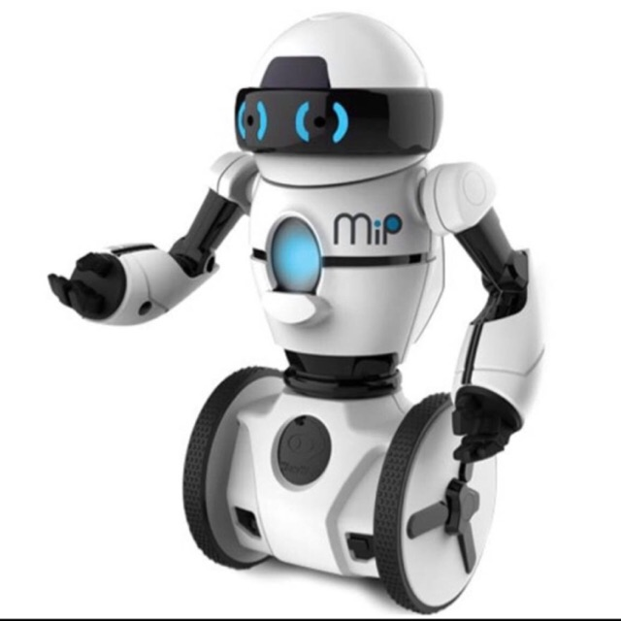
I. Topic overview
What is an obstacle avoidance robot?
Obstacle avoidance robot or mobile vehicle is defined as a vehicle capable of self-moving, autonomous (reprogrammable) under automatic control to successfully perform assigned tasks.

Slide 7
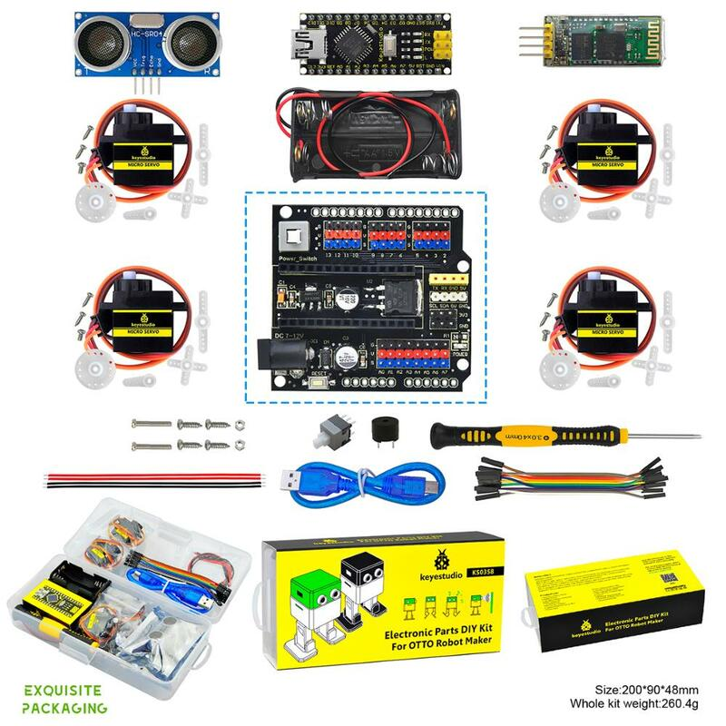
II.Hardware construction
Hardware list for robot design
Arduino Uno R3
L298N
Module Ultrasonic HC-SR04
Battery 18650
Motor

Slide 8
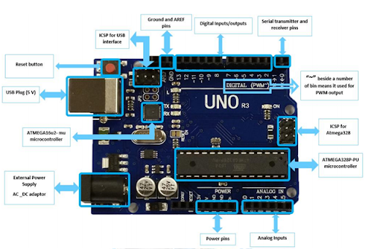
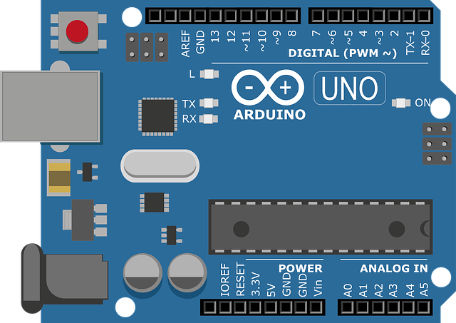
II.Hardware construction
Arduino Uno R3
Arduino Uno is a microcontroller based on the Atmega328P chip. Uno has 14 I/O digital pins (including 6 PWM pulse output legs), 6 analog input pins, 1 16MHz quartz, 1 USB port, 1 DC power jack, 1 reset button.

Slide 9
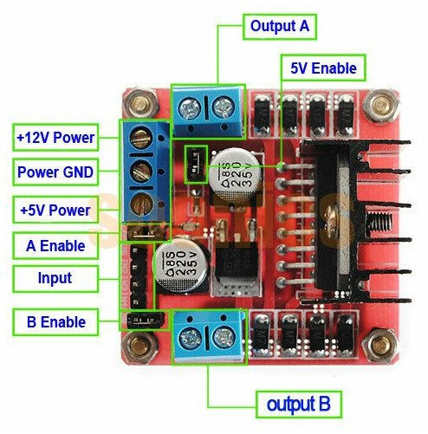
II.Hardware construction
Module L298N
Driver: L298N integrated two bridge circuits H.
Control voltage: +5V ~+12 V
Max line per H bridge is: 2A (=>2A per motor)
Voltage of control signal: +5V ~+7 V
Line of control signal: 0~36mA (Arduino can play up to 40mA should be healthy, guys)
Cost power: 20W (when temperature T = 75 °C)
Storage temperature: -25 °C ~ +130 °C

Slide 10
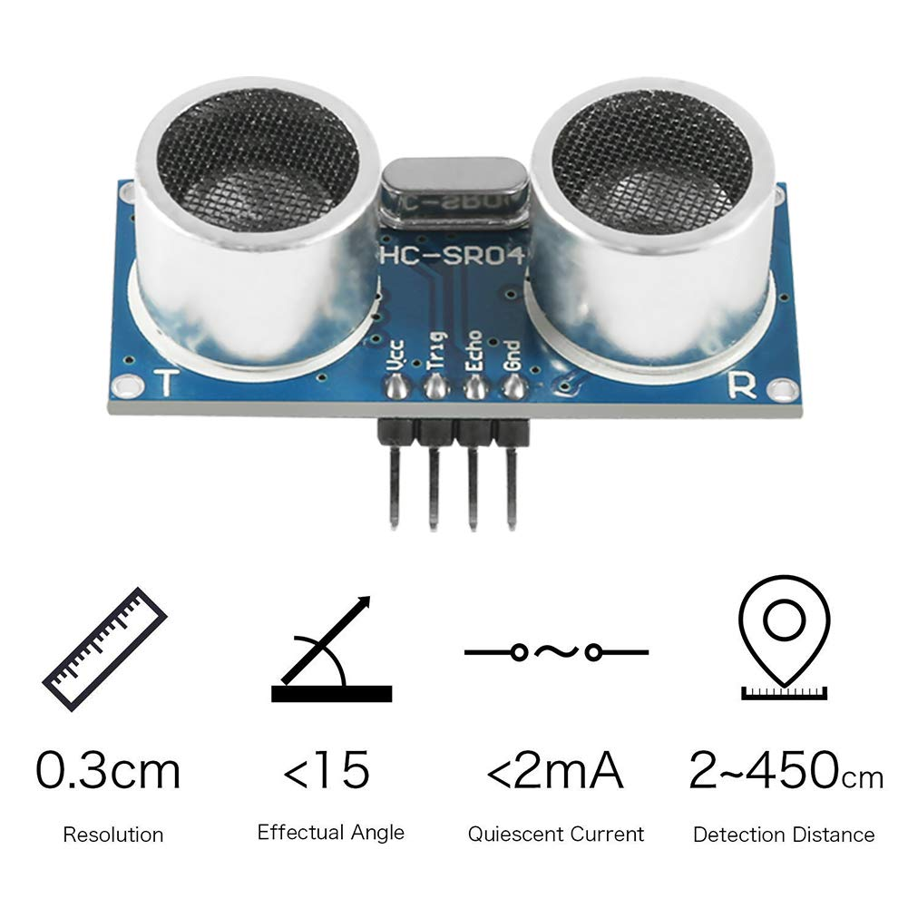
II.Hardware construction
Module HC-SR04
Operating voltage: 5V DC
Detection distance: 2cm - 450cm
Accuracy: ± 0.2cm
Input activation signal: 10us pulse TTL
Size: 43mm x 20mm x 17mm

Slide 11
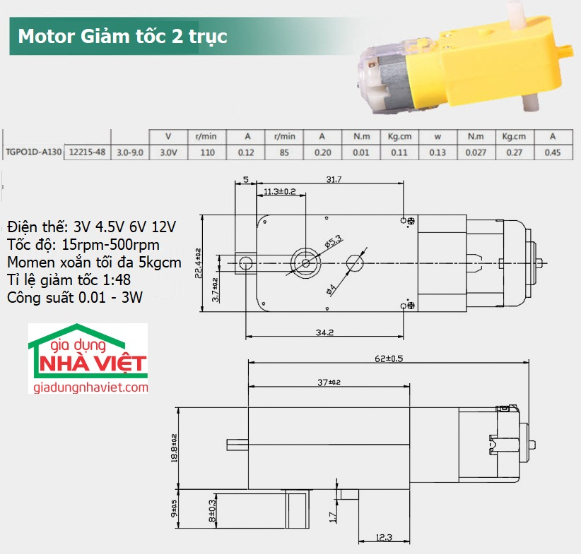
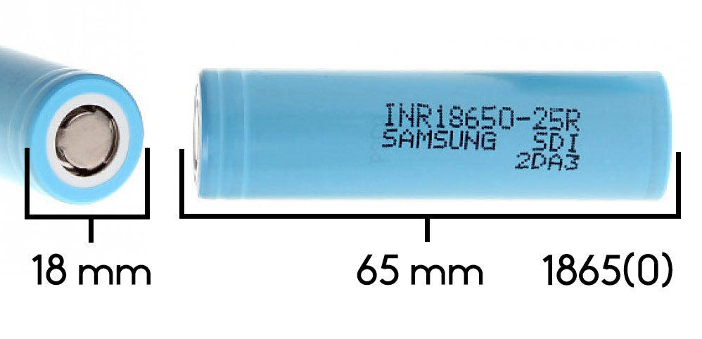
II.Hardware construction
Battery 18650
Motor

Slide 12
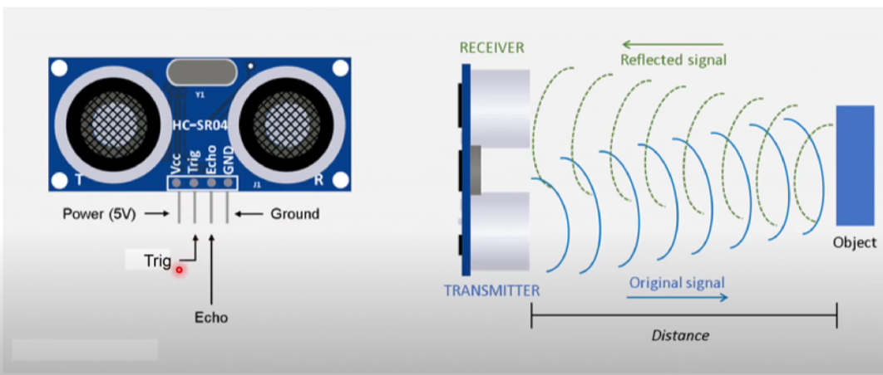
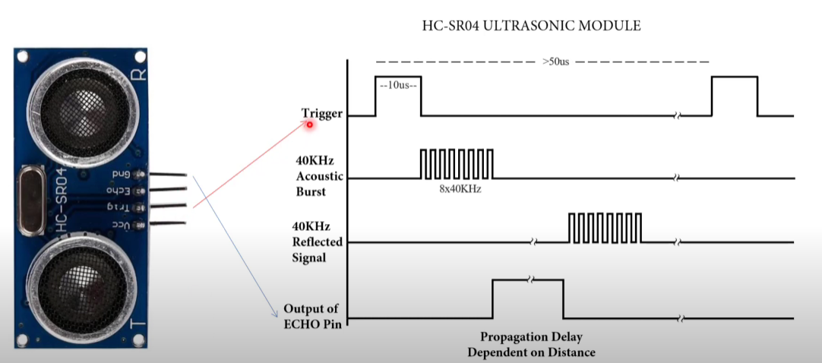
III. Principles of Operation and aplication
How does the ultrasonic sensor work?

Slide 13
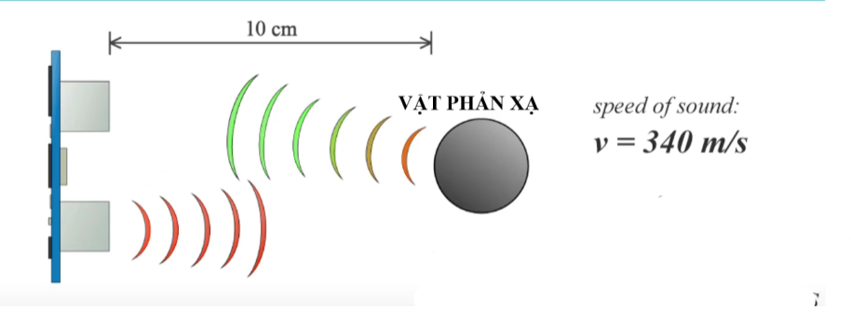
III. Principles of Operation and aplication
S = t . 0,034 / 2

Slide 14
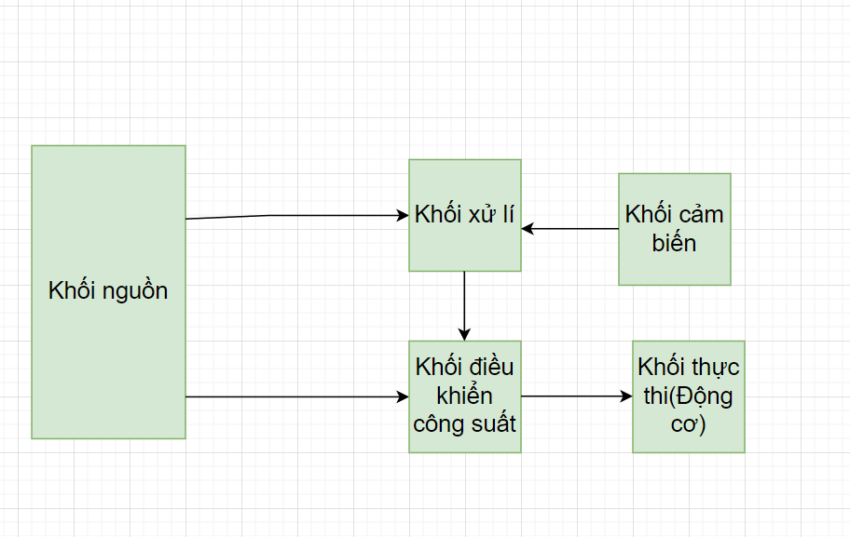
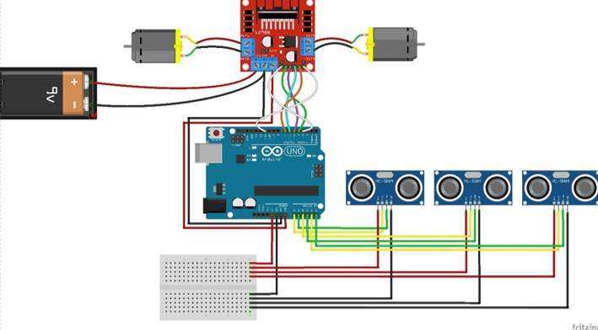
III. Principles of Operation and aplication
Obstacle avoidance robot

Slide 15
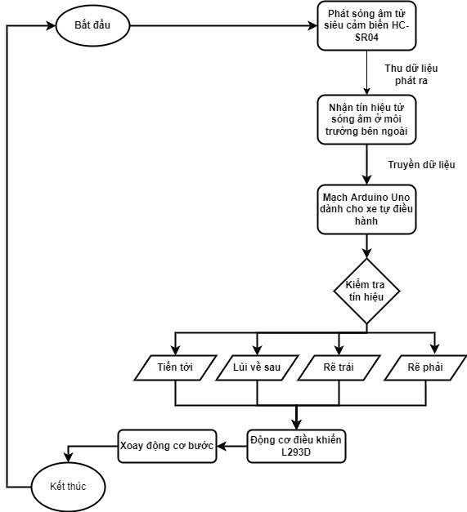
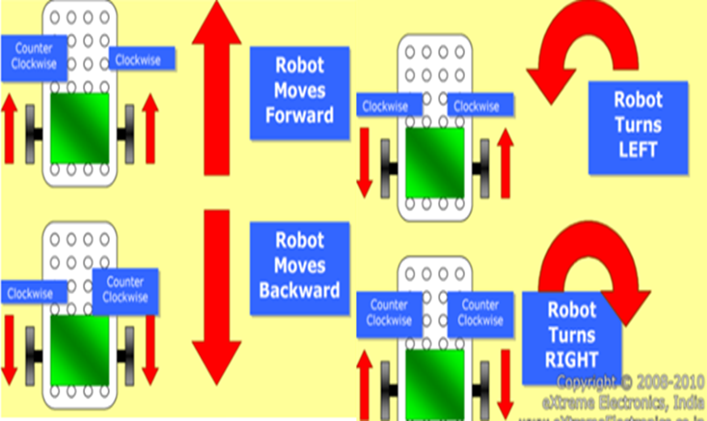
III. Principles of Operation and aplication
Obstacle avoidance robot

Slide 16
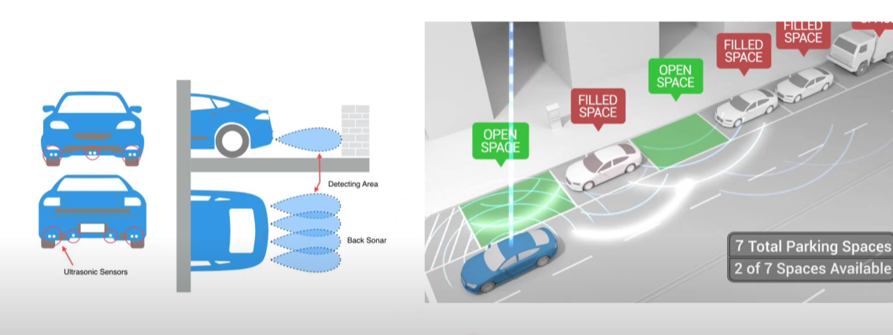
III. Principles of Operation and aplication
Aplication

Slide 17
IV.Conclusion and development direction
1.Running results and evaluation
The robot runs stably, according to the design algorithm, completes the task and demonstrates the ability to operate completely without human intervention.
- Limit:
Due to limited experience in research and design of self-propelled robots, the robot designed by our team has not met aesthetic criteria.
2. Theme development direction
- Integrate more functions for the vehicle such as: image transmission, temperature, humidity measurement, obstacle distance, tilt measurement.
- Respond to handset issues.
- Process images to identify obstacles.

Slide 18

VKU

